Slide 1
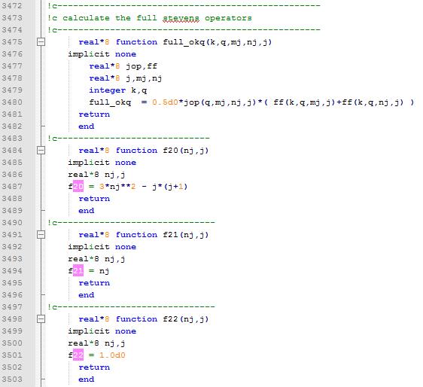
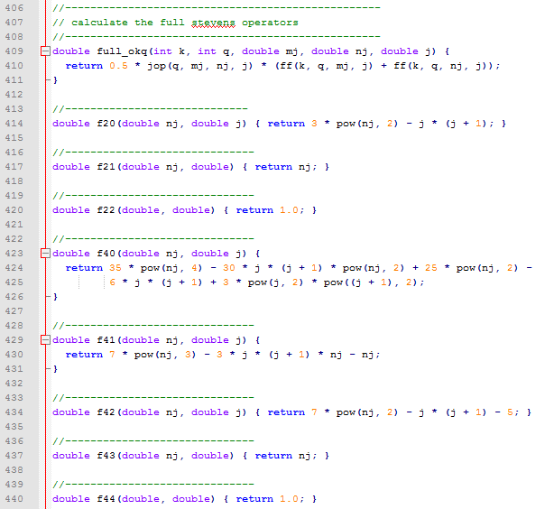
Crystal Fields Modelling and Fitting in Mantid
M.D. Le, R. Tolchenov, D.T. Adroja, T. Guidi, H.C. Walker, T.G. Perring, M.A. Gigg

Slide 2
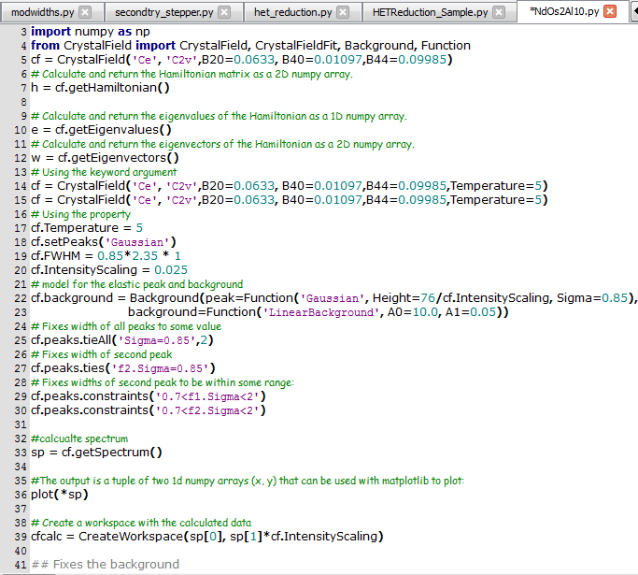
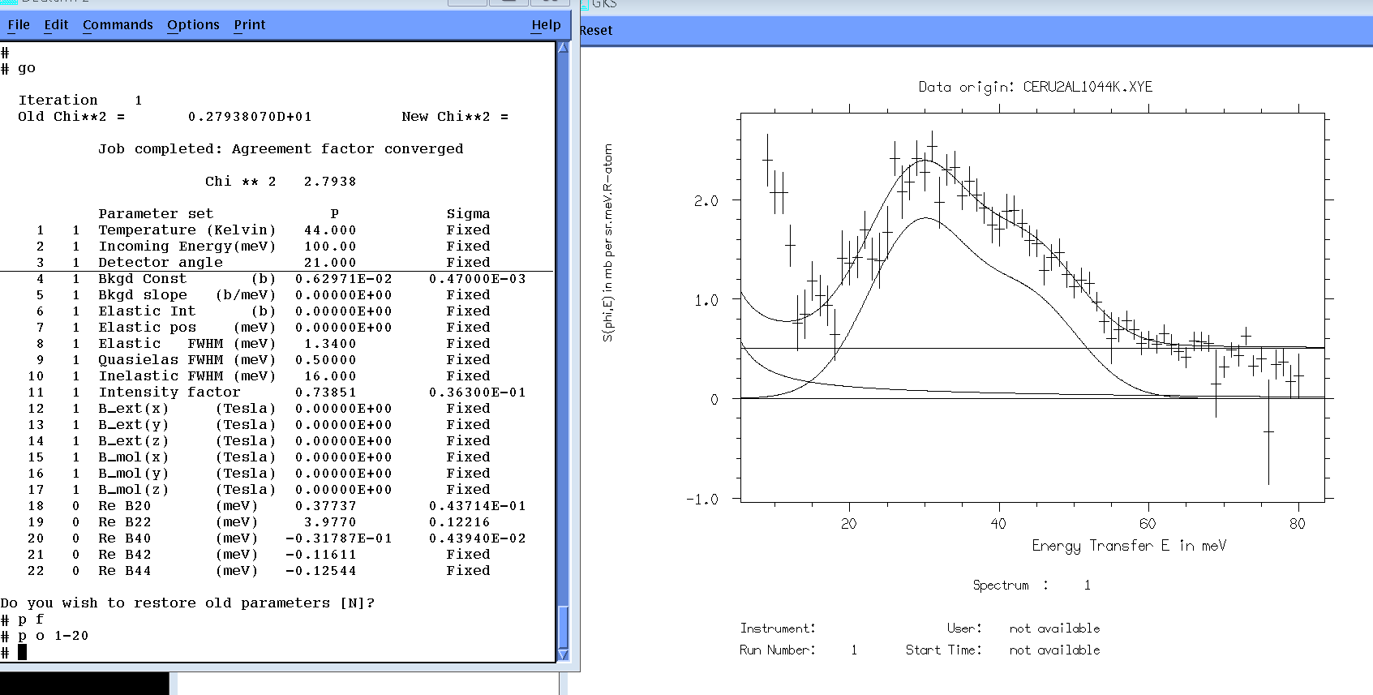
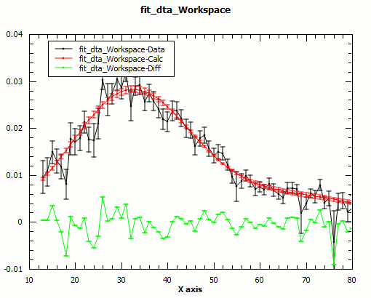
Crystal Fields Modelling and Fitting in Mantid
M.D. Le, R. Tolchenov, D.T. Adroja, T. Guidi, H.C. Walker, T.G. Perring, M.A. Gigg

Slide 3
Overview
What are crystal fields?
Why are we interested?
How are they measured by INS?
Status of the Mantid implementation

Slide 4
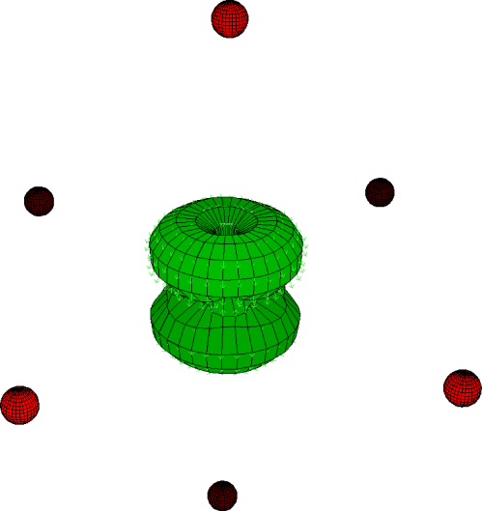
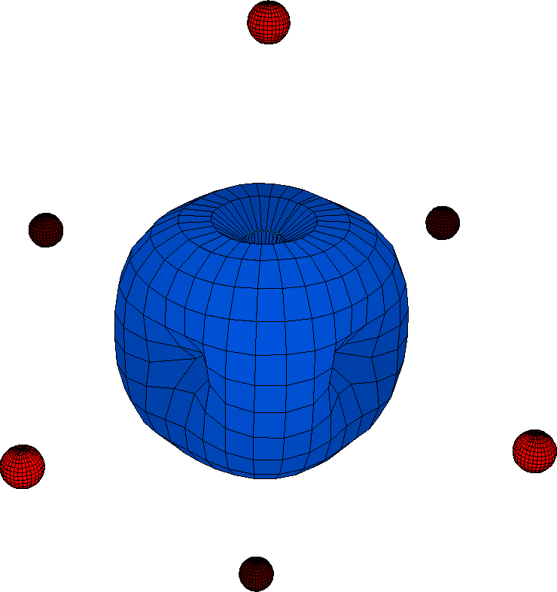
Crystalline Electric Fields
What
Why
How
Status
Electrons in a crystal experience an electric field due to the charges of the (local) surrounding ions.
This field favours particular orientations of the electronic (orbital) angular momentum, the ground state, which will have a lower energy that the others.
Orbital moment density
Charge density

Slide 5
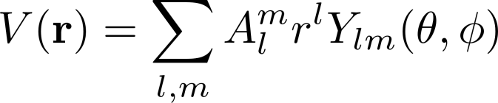
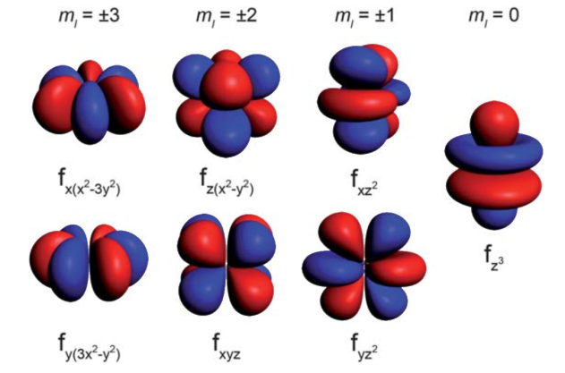
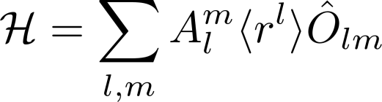
Crystalline Electric Fields
What
Why
How
Status
The electric field potential can be expressed in a multipole expansion (spherical harmonics series), which forms a complete set so it doesn’t matter that in reality, ions are not point charges.
The crystal field interaction is then parameterised by the coefficients of this expansion, called crystal field parameters.

Slide 6
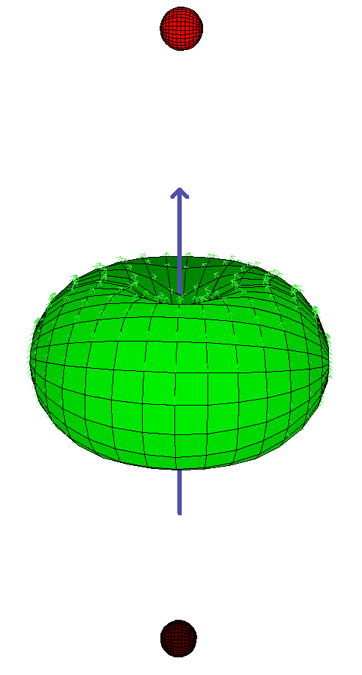
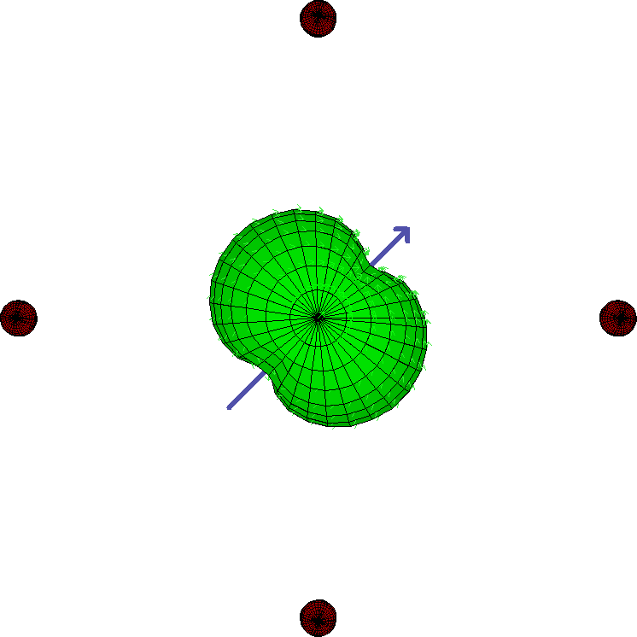
Physical Properties deriving from crystal fields
What
Why
How
Status
Magnetocrystalline anisotropy: due to the spin-orbit coupling, the orbital ground state affects the preferred spin orientations. Materials with larger crystal field splittings have higher MAE and higher coercivity – are ‘hard’ magnets, useful for motors or hard disks.

Slide 7
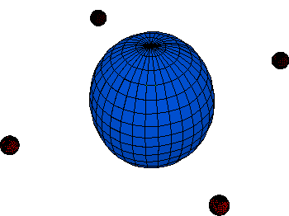
Physical Properties deriving from crystal fields
What
Why
How
Status
Magnetostriction: as crystal field levels becomes populated / depopulated with temperature or applied magnetic fields, the electron (charge) density of the magnetic ion changes, which can cause other ions to be displaced, resulting in macroscopic changes to the length of the material. Useful for transducers and actuators.

Slide 8
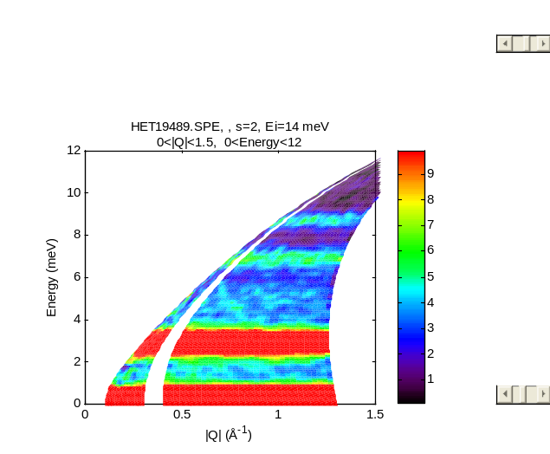
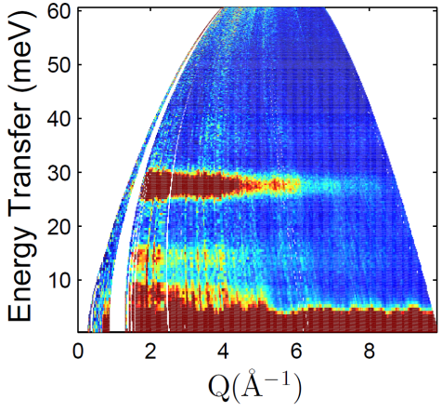
Neutron scattering
What
Why
How
Status
The energy difference between states with different orbital angular momenta caused by the crystal field can be measured by inelastic neutron scattering.
The intensity (cross-section) of the INS peaks is proportional to the dipole matrix elements between the wavefunctions of two states spanned by the transition.
Can be fitted to get the crystal field parameters.
ErB₄ (HET)
TmB₄ (IN4)

Slide 9
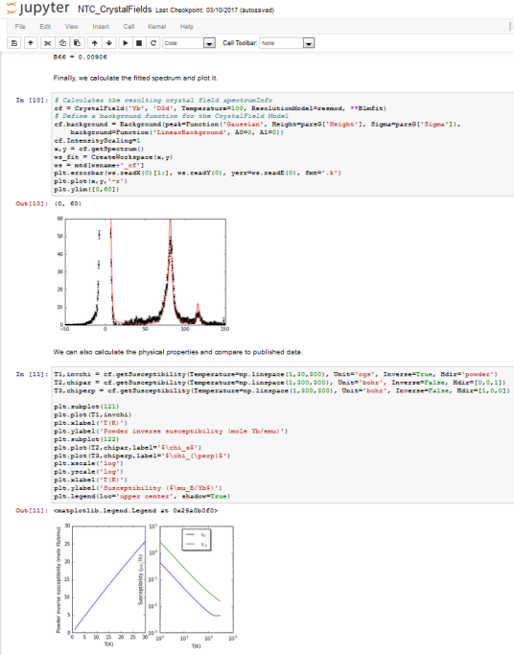
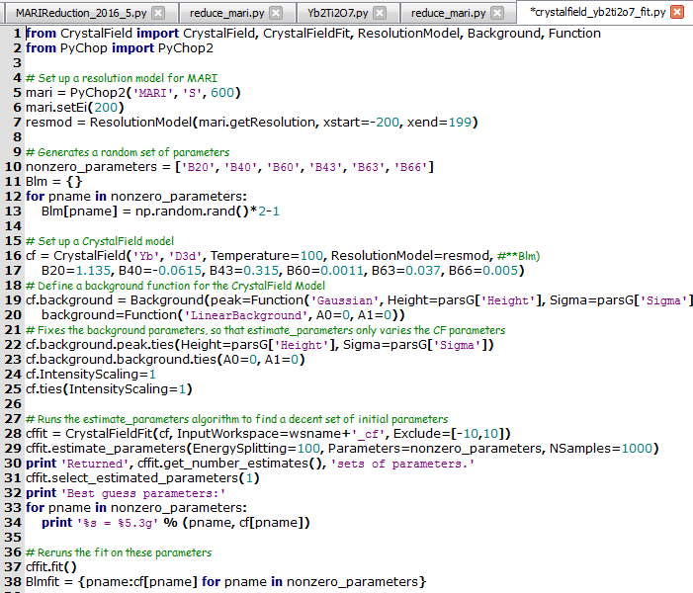
CrystalField
What
Why
How
Status
Started in March 2016 as a replacement for FOCUS
Implemented as a set of Functions for Fit (to fit INS spectra and physical properties), and a single Algorithm (to calculate the eigenvalues/energies and eigenvectors/wavefunctions and peaks/cross-sections)
90% feature complete.
Some bugs necessitated rewrite.

Slide 10
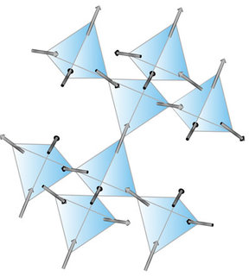
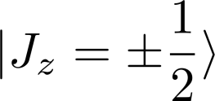
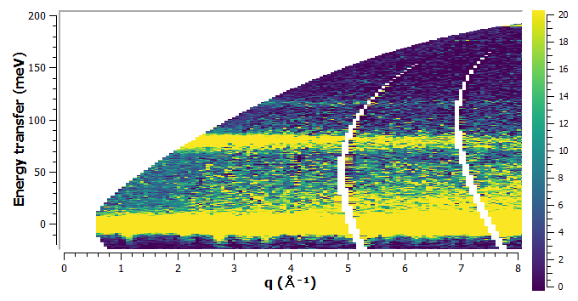
Yb₂Ti₂O₇
“Quantum spin ice”
Crystal field determines groundstate:
Used as an example in ISIS neutron training course – strong signal, topical, but relatively simple level scheme.

Slide 11
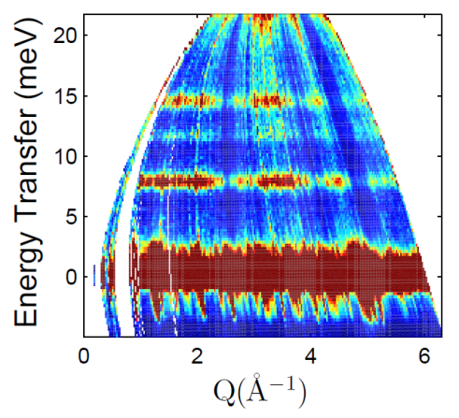
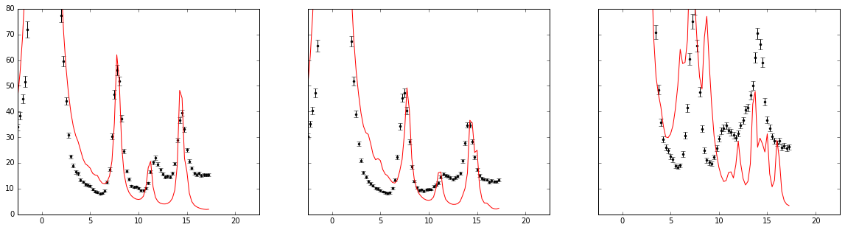
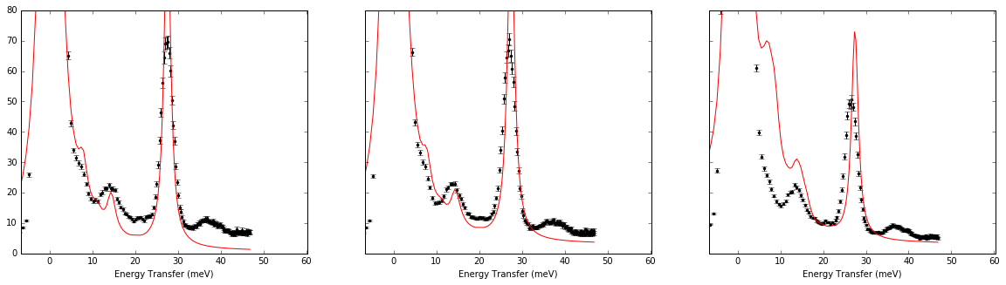
TmB₄
More complex system. Thought to form a Shastry-Sutherland lattice: a frustrated nearest / next-nearest neighbour square lattice; defining feature are magnetisation plateaus.
J=6, C_{2v}: 13 singlets
7 with “symmetric” and 6 with “antisymmetric” wfn
Transitions only between even and odd.
See 5 transitions…
T=2K
T=10K
T=50K
E_{i}=25meV
E_{i}=67meV

Slide 12

TmB₄
Simultaneous fit from initial parameters obtained by a modified point charge model (originally in Matlab, but now possible in Mantid).
Mostly fits data, but not 37meV mode.
Calculated ground state:
T=2K
T=10K
T=50K
E_{i}=25meV
E_{i}=67meV

Slide 13
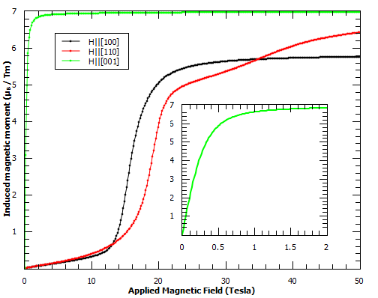
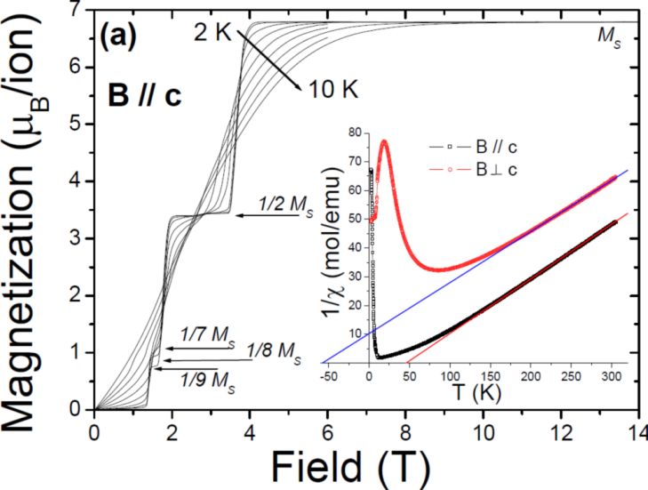
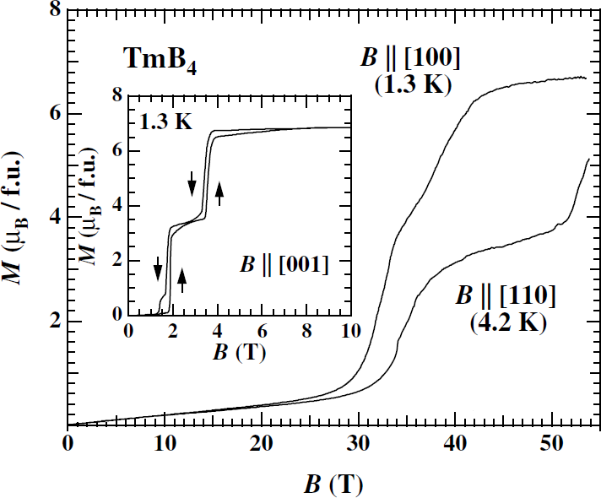
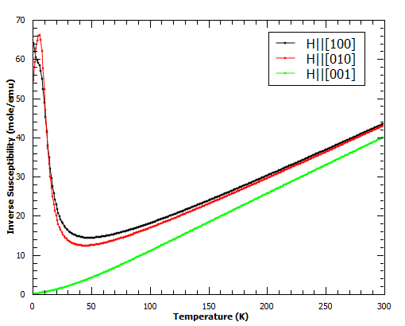
TmB₄
Calculated magnetisation from CF parameters yields some magnetisation plateaus...
… but not the most interesting
Acta Physica
Polonica A 113 (2008) 227
J. Phys.: Conf.
Ser 51 (2006) 59

Slide 14
Summary
Crystal field in Mantid functional.
Can fit data, incl. multiple datasets; with a resolution model (only widths vs energy transfer, no shape fitting – only works for simple peak shapes like Gaussian / Lorentzian at present).
Can fit INS and physical properties data simultaneously (although fit quality is often not good due to PP not constraining parameters as much as spectra)
Initial parameter estimation by Monte Carlo or point charge model.
But still work in progress… e.g. handle system with ions in multiple inequivalent sites.

